Slide 1
Controlling an IoT Device Using Amazon Alexa
Or:
how-to-setup-and-use-the-tools-to-build-local-applications-for-constrained-devices-and-the-cloud-without-pulling-your-hair.

Slide 2

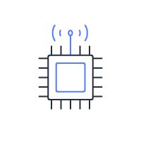
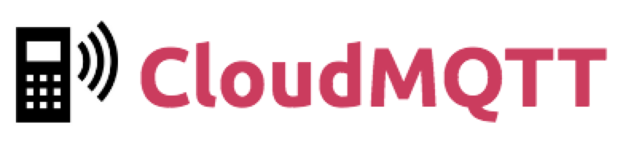


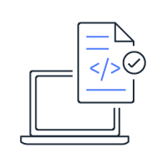
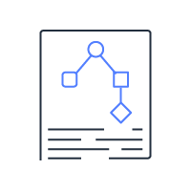


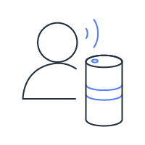
What you are going to do today

Slide 3
Some basic details
Espressif ESP32-DevKitC
ESP32-WROOM-32 SOM
Tensillica Xtensa LX6 32-bit / 240MHz / 520 KiB SRAM
4 MiB Embedded Flash
Integration WiFi 2.4GHz and BLE
PlatformIO
Open source ecosystem for IoT development
Microsoft Visual Studio Code and GitHub Atom integration
Hides the…. complexity…. of embedded development
Selection of frameworks (ESP-IDF or Arduino)

Slide 4
Details continued
CloudMQTT
Secure MQTT 3.1 broker environment
Free tier for up to 5 connected devices
Amazon Alexa
Development skill (private)
Flask-Ask for clear python code
Local execution and debugging via ngrok

Slide 5
Workshop Agenda
Configure laptop and cloud services (CloudMQTT and Alexa)
Setup your “smart device”
Program local testing and then cloud connectivity
Setup Alexa skill and back-end logic
Test with console, Alexa application, or Echo device
In lock-step – We will ensure everyone has completed each step (first one is the most challenging!)

